Slide 1
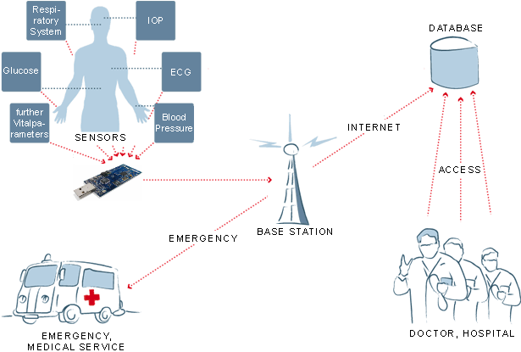
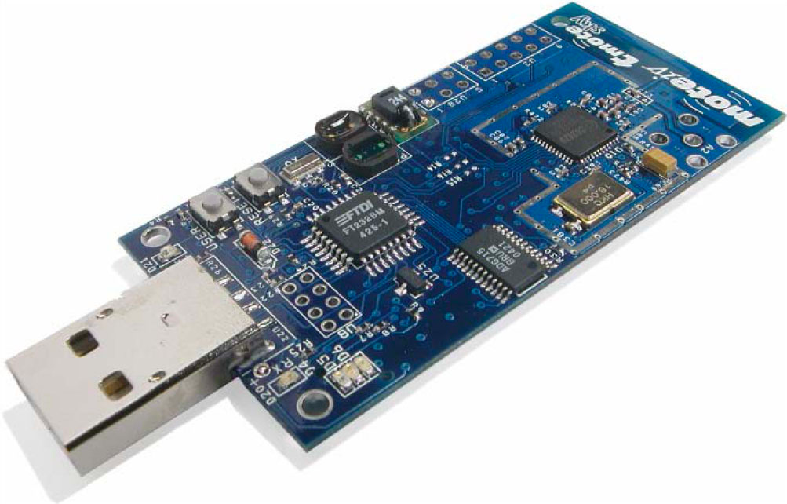


Towards Context-Oriented Programming for Wireless Sensor Networks
Mikhail Afanasov, Luca Mottola, Carlo Ghezzi
Politecnico di Milano (Italy)
Contact email: afanasov@elet.polimi.it
Healthcare System
Context-Oriented Programming for Wireless Sensor Networks
ConesC way
Evaluation:
Two applications
The same functionality
TelosB platform
ConesC binary
only 2%
bigger
nesC binary
7758 bytes vs 7640 bytes
ConesC
Translator
nesC
Ongoing Work
UBICOMP13 – Zurich (Switzerland), September 8th-12th

